Slide 1




National e-Payment
Roadmap to Thailand’s Digitalization
May 2017
Mizuho Bank Bangkok Branch
＜As of 30 May 2017＞

Slide 2
1. What is National e-Payment?
2. Overview of Planned Services
3. Effect on Tax Payment Process
4. Service Implementation Schedule
5. Q&A and Contact Information

Slide 3
1. What is National e-Payment?

Slide 4
1-1. What is National e-Payment?
The government of Thailand is currently promoting digitalization of nation known as “National e-Payment Project” by structuring a necessary platform under the titles of..
Digitalization of Governance
Digitalization of Business
Digitalization of Settlement
1. Digital Government
2. Digital Business
e-Payment System
3. Digital Banking / Payment
Overview of the project, “National e-Payment Master Plan”, is described as below.
1. PromptPay
Use registered ID (Citizen ID, mobile no etc.) for funds transfer
Increase competitiveness
2. Card Usage Expansion
The Cabinet, leaded by Prime Minister, Mr.Prayuth Chan-ocha has approved the plan in 2015.
Committee is headed by Deputy Premier, Mr.Somkid Jatusripitak and managed by Minister of Finance, Mr.Apisak Tantivorawong.
Expand card acceptance points and devices especially in rural areas
Reduce cash usage in order to reduce macro economy cost
3. e-Tax and e-Document
Facilitate e-Business to promote ease of doing business
Increase the convenience to tax payer
4.Government e-Payment
Social welfare/ Direct disbursement through PromptPay
Transform the Government payment and collection to e-payment
5. Educating and Promoting
Conduct literacy programs and incentive campaigns to promote
the use of e-Payment

Slide 5
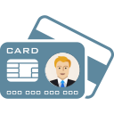


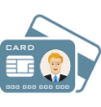




1-2. What is “PromptPay” service?
“PromptPay” is a so-called title of “AnyID utilized Settlement” which allows customers to use certain codes (AnyID) to transfer instead of bank account numbers.
＜Personal＞National Citizen ID、Mobile no.、E-mail address, etc..
＜Corporate＞Tax ID
Before starting “PromptPay”, personal/corporate codes must be registered under “National-ITMX” (Thai settlement management institution) to tie up with a related bank account.
There are two modes of payment: real-time single payment & bulk payment
<STEP1>
<STEP2>
①Payment requested by Specifying Citizen ID
Citizen ID
1231231231234
Bank A/Savings Acc.
No.1234567
N-ITMX
System
Register Citizen ID/Mobile no. with your bank account
Payer
Payment data
②Payment requested by specifying Mobile no.
Receive at registered bank acc.
Mobile no.
099-999-9999
Bank B/Savings Acc.
No.9876543

Slide 6







Digitization
Less Fee
Cost Reduction
$
Promote electronic financial services and enhance efficiency of the financial system.
Offer less transfer fee. All transactions up to 5,000 baht are free (Individual Customers).
A Bank has estimated 1 billion baht can be cut each year due to less cash logistic and management costs.
Registered Number
20,000 Corporates
21,000,000 Users
Transaction Number
4.3 M TXNs
30 Billion Baht
100,000 TXNs/Day
+500%
Reference : BOT
Data as of March 2017
Notes:
https://www.matichon.co.th/news/512007
https://www.thunhoon.com/%E0%B8%98%E0%B8%9B%E0%B8%97-%E0%B8%A5%E0%B8%B8%E0%B9%89%E0%B8%99%E0%B8%A2%E0%B8%AD%E0%B8%94%E0%B8%9E%E0%B8%A3%E0%B9%89%E0%B8%AD%E0%B8%A1%E0%B9%80%E0%B8%9E%E0%B8%A2%E0%B9%8C%E0%B8%9E%E0%B8%B8%E0%B9%88/
http://www.moneyandbanking.co.th/new/news/detail/13607?category=27
https://www.kasikornbank.com/EN/News/Pages/Promptpay.aspx
https://www.bot.or.th/Thai/PaymentSystems/PSServices/PromptPay/Documents/AboutPromptPay.pdf

Slide 7
Readiness of Mizuho toward National e-Payment
To support Thai government’s “digitalization of nation”, Mizuho is proactively promoting National e-Payment.
We’ve already launched “PromptPay” service on 27 Jan 2017, before other foreign banks. “PromptPay” for corporate customers has been effective on 1 Mar 2017, as same as other member local banks.
Mizuho actively engages with Revenue Department of Thailand to support e-Tax initiative and catch the latest information directly from the source.
For the other scheduled services, we are preparing for the systems to launch accordingly on the release dates.
※Please kindly understand that launch of scheduled services is not confirmed.
Values Mizuho Provides with “National e-Payment”
Reduce cost both bank fee and operational cost
Increase liquidity by shorten the collection time from payer
Fast and easy for tax payment and tax document
Tax Incentive
Cheque and Cash transaction, which are high cost payment methods, will be replaced.

Slide 8
2. Overview of Services in Preparation

Slide 9




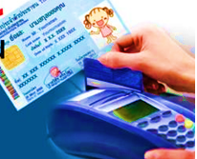
2-1. Introduction of Additional Settlement Services
BahtNet
Media Clearing(SMART)
Direct Credit
Cheque Payment
Cheque Collection
PromptPay
Services in operation
“PromptPay” related services in preparation
Cash Management Solution
Bill Payment
＆
Biller Service
(A/R Reconciliation)
e-Tax Filing
&
Tax Payment
And more …
Request to Pay

Slide 10



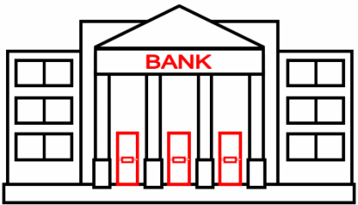
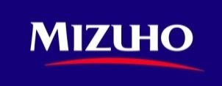
2-2. What is “Biller Service”?
Biller service which allows biller to request and payer to make payment at banks of their choices.
Normally, payer must pay at a biller’s requested banks. For payer’ convenience, billers would open account with many banks, and reconcile multiple bank accounts.
Under PromptPay scheme, payer can make payment at any “PromptPay” member banks. Funds will be collected to a single biller’s bank automatically.
Banks can match bills and payment information to reduce workload for A/R reconciliation.
2. Send Bill to Payer
Biller（Your co.）
Payer(Customer)
1. Send Bill Information via MGeB
8. Credit Payment
9. Match bills and payment
information and upload bill
reconcile file
3. Payment information
via Paying Bank
(eg. Moblie Banking)
MGeB
5. Bill Information Confirmation
N-ITMX
System
Biller’s Bank
Paying Bank
4. Bill Information Inquiry
7. Payment Instruction
6. Verify Bill Information
and Debit from Account

Slide 11
2-3. What is “Request to Pay”?
Biller sends Debit Request to Bank with Bill Information. Payer receives Debit Notice with Bill Information from their Bank and once approve, the fund shall be transferred to Biller’s account.
Biller needs not send paper Bill to the payer, but to the Biller’s Bank as data only.
Payer can make payment at any “PromptPay” member banks.
Banks can match bills and payment information to reduce workload for A/R reconciliation.
Biller（Your co.）
Payer(Customer)
1. Send Debit Request with Bill Information via MGeB
7. Credit Payment
8. Match bills and payment
information and upload bill
reconcile file
4. Approve
Debit Notice (eg. On Mobile Banking)
3. Debit Notice with
Bill information
MGeB
2. Debit Request with Bill Information
N-ITMX
System
Biller’s Bank
Paying Bank
6. Payment Instruction
5. Debit from Account

Slide 12

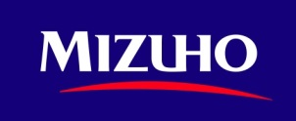
2-4. What is “Bill Payment”?
Payment service which payer can make payment at bank of its own choice according to information based on payment request from biller.
This will increase the convenience of customers, and increase bank’s competitiveness against convenience store, for example.
1. Receive Bill from Biller
Biller (Supplier)
Payer (Your co.)
7. Credit Payment
2. Send Payment
Information via MGeB
MGeB
4. Bill Information Confirmation
N-ITMX
System
Paying Bank
Biller’s Bank
3. Bill Information Inquiry
6. Payment Instruction
5. Verify Bill Information
and Debit from Account

Slide 13
























PromptPay Bill Payment Framework
Customer A/C
i.e. Automobile Company A/C
Alliance Banks
*** Pay to Any Banks at Anywhere, Even though No Account ***
Bangkok
Phuket
Chiang Mai
Ayutthaya

Slide 14
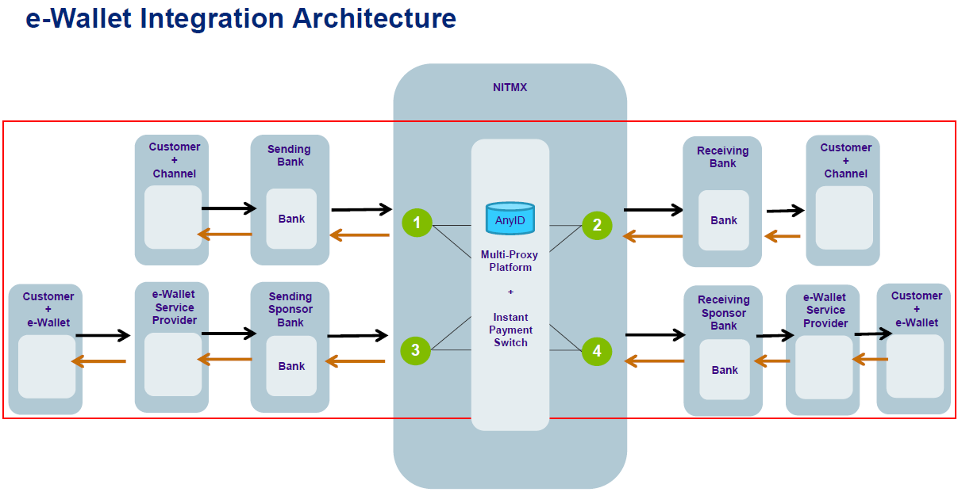
Source: ITMX

Slide 15
3. Effect on Tax Payment Process
3. 納税手続への影響

Slide 16

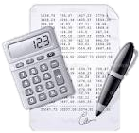





3-1. Change in WHT & VAT Payment Process ～①Current Process
＜Customer Workflow＞
Payment Instruction
Payment
Tax Payment Instruction
（at each tax cycle）
Payer
(Customer)
Payment Account Booking
Vendor
(Beneficiary)
Tax Payment
Send WHT Certificate
WHT：Withholding Tax
VAT ：Value Added Tax
Issue WHT Certificate
Document Storage
Key Points:
Required to send Tax Certificate to Beneficiary
Both payer and beneficiary are required to store physical Tax documents
Payer owns obligation to pay WHT and report VAT to RD monthly.
Send Report Online
Monthly
WHT Payment
& VAT Report
Revenue Department

Slide 17


3-2. Change in WHT & VAT Payment Process ～②Future Process
Payer sends payment instruction with tax information every each transaction.
By providing necessary tax information of payer to beneficiary, issuance of “WHT Certificate” (paper media) is substituted.
At the same time, banks proceed tax payment application every each transaction to which customers no longer have to conduct monthly WHT payment and VAT online report.
*Workfolw of VAT payment by beneficiary will not be changed.
Not only “PromptPay” related services, but also standard payment services take the same procedure.
＜Customer Workflow＞
Payment
with Tax Information
Payment Instruction
with Tax Information
Payer
（Customer）
or
Beneficiary
（Supplier）
Payment Account Booking
Tax Payment
※Services explained above are based on information announced by Revenue Department. Please kindly understand that we are under the assumption of law reform act for electronic tax payment in future.
Revenue Department

Slide 18


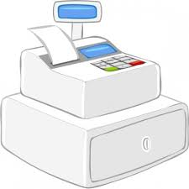


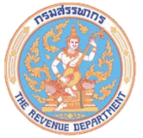
3-3. Draft of Amendment in “Revenue Code”: Guideline for WHT & VAT
All companies must comply this new workflow of WHT & VAT in the future.
2. TAX Information & TAX Filling must be submitted
to Mizuho Bank – Approximately 26 Fields
are required.
3. Tax Information will be sent to Revenue Department on Daily basis.
4. Tax information of every transaction must be submitted although not subject to tax
5. Tax Payer must pay withholding tax immediately once the payment occurs
6. Tax Payer has no need to issue WHT certificate

Slide 19
4. サービス導入に向けたスケジュール
4. Service Implementation Schedule

Slide 20
4-1. Timeline for Service Implementation
Registration of personal ID with Citizen ID & Mobile Phone No. had started in July, 2016.
Starting off with “PromptPay Bulk Payment”(G2C) on Dec 2016, and core service,“PromptPay”, is officially launched on 27 Jan 2017 for C2C. And the services for corporate (B2C & B2B) has been launched on 1 Mar 2017.
The launches of other services are following in Nov 2017. And it is expected at this moment that new tax payment process will be implemented on Jun 2018 onward.
Starting Personal ID Registration
Go live PromptPay Bulk Payment (GtoC)
2016
個人ID登録受付開始
2017
2018
Jul
Nov
27 Jan
1 Mar
Aug
Nov
Jun onward
Go Live PromptPay Single/Bulk Payment (C2C)
TaxID Registration
Go Live PromptPay Single/Bulk Payment (B2B,B2C, C2B)
Connect e-Wallet to PromptPay Network
Go live Request to Pay Bill Payment Biller Service
Go live e-Tax
To be determined...
※This “Timeline” is made based
on the information as of
7 Apr 2017.
Completed
Completed
Completed
Completed

Slide 21
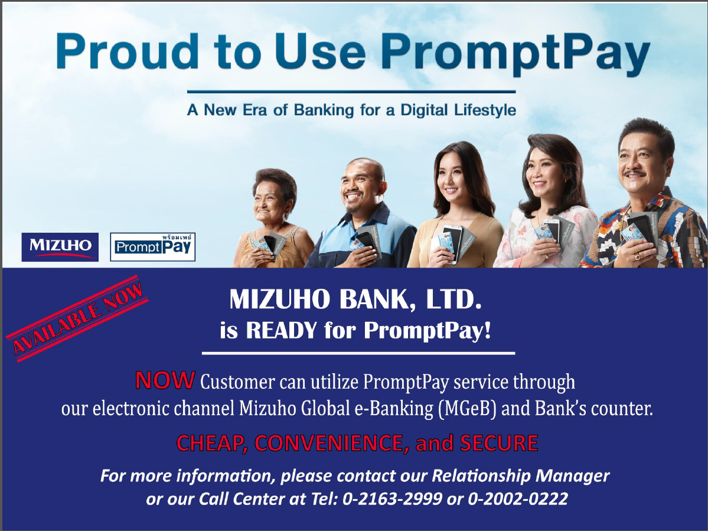

Slide 22
5. Q&A and Contact Information

Slide 23
5-1. Frequently Asked Questions①
<Q1>
Do I always have to use PromptPay to transfer funds once service is in operation?
<A1>
No. However, there will be advantages on fees and limitation of time for PromptPay.
<A2>
Yes. A single Tax ID can only tie up with a single bank account for now. Nonetheless, Biller Service can tie up with a maximum of 99 bank accounts.
<Q2>
In case of corporate customers, can a single Tax ID only tie up with a single bank account?
<Q3>
May I change a registered bank account after registration of the bank account and Tax ID?
<A3>
Yes. After you apply for cancellation and approved, you may register another bank account including of other banks.

Slide 24
5-2. Frequently Asked Questions ②
<A4>
Fee table in Mizuho is …
- 100,000 baht or less: 10baht
- over 100,000: 15baht
Same fee will be applied for Single and Bulk Payment.
<Q4>
How much fees does Credit Transfer service with PromptPay cost?
<Q5>
When is the cut-off time for sending data on Credit Transfer service with PromptPay?
<A5>
It depends on each bank. For Mizuho, once cut-off time is confirmed for each service, we will announce.
<A6>
Yes. Banks return billing information when funds transfer. As a result, customers will no longer have to reconcile account receivables by yourselves.
<Q6>
Can Biller Service be used for commercial transactions between general corporations?

Slide 25

5-3. Contact Information
Please contact us if anything is unclear to you.
02-163-2999
02-002-0222
Services in General and M-GeB
Remittance
Business Solution Div.
Remittance/e-Payment Div.
Mr.Horikawa(Japanese)
Mr.Virad(English/Thai)
Ext.：2700
Ext.：2710
Ms.Suwanna(Thai)
Ms.Paphan(Thai)
Mr.Piyapat(Thai)
Ext.：3230
Ext.：3233
Ext.：3231
Please feel free to ask our BPs any questions!

Slide 26
© 2017 Mizuho Bank, Ltd.
This document was created for the purpose of discussions with your company, various conditions indicated in this document are based on assumptions, and the accuracy and completeness of the information in this document are not guaranteed. The analysis in this document is based on assumptions, and the accuracy and completeness of the related information in this document are not guaranteed. In addition, because the analysis in this document is based on assumptions, the accuracy and completeness of the results are not guaranteed.
Depending on future information disclosure, valuation, the views of credit agencies, changes to systems or the financial environment, and other factors, it might become necessary to considerably change the related assumptions and schemes, and, in this case, please understand that it might not be possible to achieve the results of the analysis in this document. In addition, this document does not comprehensively list all the risks faced by your company.
Regarding the schemes included in this document, only conclude agreements at your company's discretion based on a thorough understanding of the risks involved. In addition, contact lawyers, public accountants, tax accountants, and other suitable professionals regarding the handling of laws, accounting, and taxes. Unless Mizuho concludes a separate agreement, etc. that indicates otherwise, Mizuho is not an advisor to your company, and this document is not intended to provide transaction advice to your company.

